Slide 1
How to Win: the Value Proposition
Training
15 July 2025

Slide 2
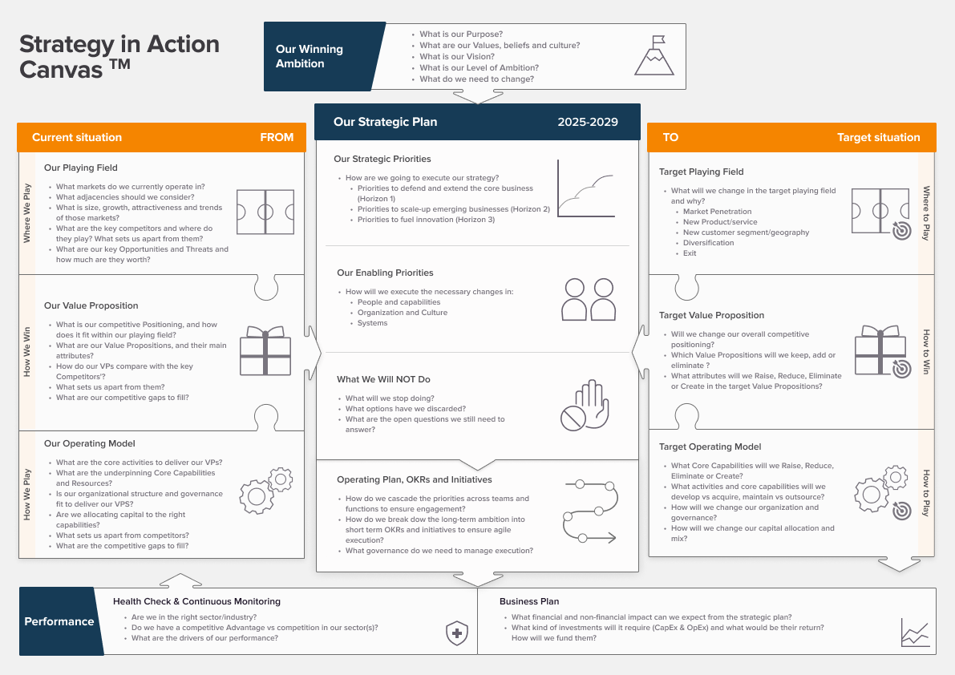


Canvas
Analysis of the Current & potential Target Situations:
How to Win
(The Value Proposition)

Slide 3
Table of Contents
What It Is and Why It Is Important
Key Strategic Choices
Diagnostic Questions
Key Concepts & Frameworks
Value Proposition - What It Is and Why It Is Important
Key Strategic Choices
Choice of Strategic Positioning
Choice of Generic Positioning
Choice of Positioning Archetype
Choice of Segmentation of Value Propositions
Design/Enhancement Choices for each Value Proposition
Selection of Value Attributes to Focus On
Choice of Competitive Benchmarks
Value Innovation Design
Strategic Pricing
Diagnostic Questions
What is our current strategic positioning?
What is our current segmentation of Value Propositions?
How do our Value Propositions compare with our most significant competitors – what sets us apart?
Diagnostic Pitfalls to Avoid
Key Concepts and Frameworks underpinning the Value Proposition
The Value Stick Framework
The Elements of Value Framework
The Three Value Disciplines Framework
The Jobs To Be Done Framework
The Four Actions Framework

Slide 4
What It Is & Why It Is Important
What It Is and Why It Is Important
Key Strategic Choices
Diagnostic Questions
Key Concepts & Frameworks
The Value Proposition is the explicit promise an organisation makes to its customers about the specific and unique combination of benefits it will deliver and the relative price at which those benefits will be available.
It bridges the gap between where you have chosen to compete – your playing field – and your internal capabilities, how you will organise to deliver results – your operating model.
To thrive, organisations can either orchestrate multiple dimensions of value in ways that competitors find difficult to match or develop the dynamic ability to change and adapt their value proposition rapidly.
Crafting a strong value proposition is how you win in your chosen playing field
How to Win
(Value Proposition)
Where to Play
(Playing Field)
How to Play
(Operating Model)

Slide 5
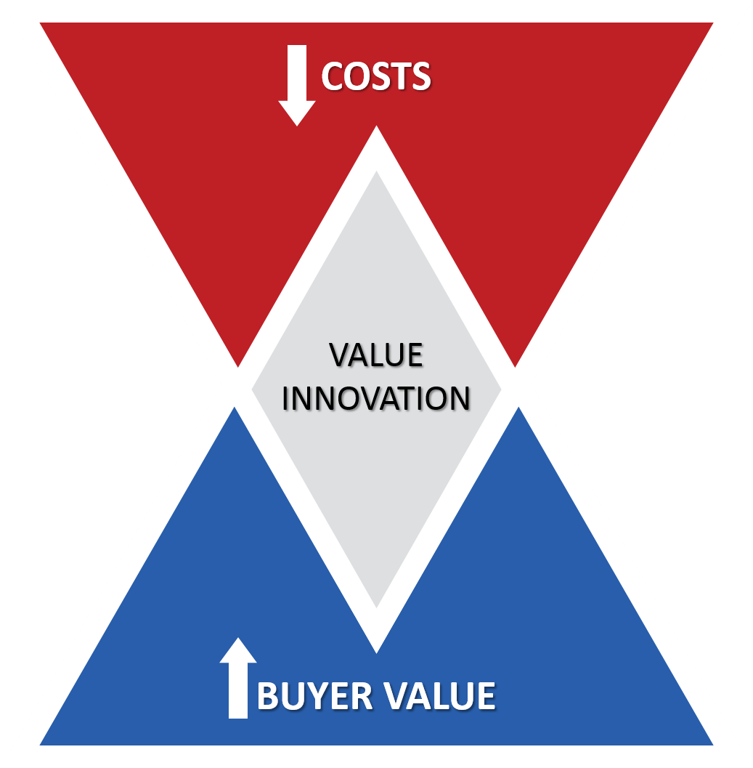
Creating value through trade-offs
What It Is and Why It Is Important
Key Strategic Choices
Diagnostic Questions
Key Concepts & Frameworks
Porter reminds us that value is created by either lifting customers’ value or willingness to pay (WTP) or lowering the total cost borne by suppliers, employees, and investors.
Winning value propositions hinge on an explicit, competitor-relative trade-off between these two levers and on orchestrating functional, emotional, experiential, and complementary benefits to customers.
Real advantage comes from a unique “recipe” that blends WTP-raising and cost-cutting ingredients in proportions rivals cannot or will not replicate, rather than from any single feature they can copy.
Strategic trade-offs keep firms out of feature or price wars and focused on delivering truly differentiated value.
Great strategies develop Value Propositions at the optimal point between Value and Cost
You have a Value Proposition only if….
C < P < V
Cost < Price < Customer Perceived Value

Slide 6
The Value Perception Gap
What It Is and Why It Is Important
Key Strategic Choices
Diagnostic Questions
Key Concepts & Frameworks
The Value Perception Gap is the often significant gap between what customers actually experience and value and what you think you deliver.
In an increasingly commoditised world, your value proposition isn't just part of your strategy - it is the core of your strategy.
This module will equip you with frameworks to diagnose your current value position, identify opportunities for enhancement, and make deliberate choices about how to create superior value for your chosen customers.
Bridging the Value Perception Gap
Misaligned Value Proposition
Understand Customer Needs
Strong Value Proposition
Intended vs. Perceived Value
Customer needs are effectively met
Uncover functional, emotional, social needs
Evaluate current value proposition effectiveness
Deliberate choices for superior value

Slide 7
Key Strategic Choices
What It Is and Why It Is Important
Key Strategic Choices
Diagnostic Questions
Key Concepts & Frameworks
These choices determine how you'll differentiate your offering and capture customer preference in your chosen markets.
The ultimate purpose is to design one or more distinctive Value Propositions, making explicit decisions about in what specific customer benefits you will outperform competitors, those in which you will settle for an "at par" performance, and those which you will eliminate or reduce.
All the choices need to be aligned with one another and with the where to play and how to play choices.
Three Fundamental Choices when creating a winning Value Proposition
1. Strategic Positioning
Generic Positioning
Positioning Archetypes
2. Segmentation of Value Propositions
3. Design Choices for each Value Proposition

Slide 8
The Strategy Value Curve
What It Is and Why It Is Important
Key Strategic Choices
Diagnostic Questions
Key Concepts & Frameworks
The Strategy Value Curve compares several organisations and assesses the relative performance (offering level) of each on a selection of value attributes, which are ranked according to their importance to a customer segments.
Price, in relative or absolute terms, is assessed separately.
Throughout this module we will be expanding on the creation and study of this analysis.
What the Strategy Value Curve is and How it works
Relative Performance
Price
Organisation 1
High
180 €
180€
160 €
Organisation 2
ILLUSTRATIVE
120 €
120€
Offering level
100 €
Organisation 3
60 €
60€
40 €
Low
0
Importance
4 | 3.8 | 3.7 | 3.3 | 3.2 | 3.2 | 3.1
Competing Factors

Slide 9




The Strategy Value Curve: Streaming
What It Is and Why It Is Important
Key Strategic Choices
Diagnostic Questions
Key Concepts & Frameworks
Example: Strategy Value Curve of Streaming Platforms
Each streaming platform represents a fundamentally different recipe for value creation, demonstrating how the same broad industry can support multiple value propositions, through unique combinations of pricing, targeting, and value attributes. Each player exploits a distinct corporate advantage—hardware (Apple), global scale (Netflix), IP franchises (Disney) or commerce (Amazon)—rather than racing to copy the others.
Price
Relative Performance
Disney+
High
16
15€
Amazon Prime Video
13€
Offering level
Netflix
Apple TV+
10€
Low
Importance
4 | 4 | 5 | 4 | 3 | 3 | 4 | 4
Competing Factors

Slide 10
Choice of Generic Positioning
What It Is and Why It Is Important
Key Strategic Choices
Diagnostic Questions
Key Concepts & Frameworks
In Cost Leadership, the low relative prices are enabled by superior efficiency across the entire value chain.
In Differentiation, higher relative prices are commanded by creating superior value, and it being perceived by customers.
Blue Ocean or Hybrid Strategy allow pursuing differentiation and low cost by reconstructing industry boundaries and eliminating the traditional value-cost trade-off. It creates new demand, rather than fighting over existing customers, and is enabled through systematic value innovation.
Margin
Similar pricing
Different (LOWER) cost structure
Advantage derived from cost
Cost Leadership
Price
Cost
ADVANTAGE
Company
Industry
ROIC
Margin
Different (HIGHER) pricing
Similar cost structure
Advantage derived from pricing
Differentiation
Price
ADVANTAGE
ADVANTAGE
Cost
Company
Industry
Company
Industry
Different pricing
Different cost structure
Advantage derived from both pricing and cost structure
Creation of new, unconstested market spaces
Margin
Blue Ocean Strategy
Comparison at same volumes
Price
ADVANTAGE
Cost
ADVANTAGE
Company
Industry

Slide 11



Choice of Generic Positioning: Cost Leadership
What It Is and Why It Is Important
Key Strategic Choices
Diagnostic Questions
Key Concepts & Frameworks
Example: Strategy Value Curve of Ryanair and Competitors
Cost leaders are not the cheapest providers, in absolute terms, but those which can compete withing industry-average prices, their advantage stemming from the superior margin resulting from similar prices than competitors, at much lower costs.
The strategic power of this approach lies in creating sustainable structural cost advantages that competitors cannot easily replicate without fundamentally changing their own strategies.
Ryanair has a radical cost structure (fleet standardisation, choice of airports, etc) and delivers best-in-class value on some critical attributes for customers, enabling it maintain its cost leadership advantage across decades.
Price
Relative Performance
British Airways
180 €
180€
High
160 €
Thomson
120 €
120€
100 €
Offering level
Ryanair
60 €
60€
40 €
Low
0
Importance
4 | 3.8 | 3.7 | 3.3 | 3.2 | 3.2 | 3.1
Competing Factors

Slide 12



Choice of Generic Positioning: Differentiation
What It Is and Why It Is Important
Key Strategic Choices
Diagnostic Questions
Key Concepts & Frameworks
Example: Strategy Value Curve of Louis Vuitton and Mass-Market Competitors
Differentiation increases the customer’s WTP through functional improvements, emotional benefits, or experience enhancements; they value the unique benefits enough to pay more than they would for alternatives.
It can occur across multiple dimensions and throughout the value chain, and it must be economically sustainable.
Louis Vuitton maintains 300-500% higher price than mass-market alternatives, delivering unmatched value on customers’ most critical luxury attributes
Relative Price
Relative Performance
Louis Vuiton
High
100
Offering level
Coach
25
15
Low
Michael Kors
Importance
4 | 3 | 5 | 5 | 4 | 4 | 3
Competing Factors

Slide 13



Choice of Generic Positioning: Blue Ocean
What It Is and Why It Is Important
Key Strategic Choices
Diagnostic Questions
Key Concepts & Frameworks
The power of Blue Ocean Strategy consists in creating new demand rather than competing for existing demand, by reconstructing market boundaries.
It requires whole-system alignment across utility, price, cost, and people propositions to sustain value innovation over time.
When Apple launched the iPhone, it created an entirely new category of value that redefined customer expectations, by creating a platform instead of competing on hardware specifications.
The platform approach delivered unprecedented personalisation, continuous value enhancement, ecosystem integration and future-proofing.
Apple also achieved manufacturing cost advantages through a low SKU complexity, network effects of the app store, while still appealing to infinite customer diversity.
Example: Strategy Value Curve of Apple’s iPhone and Competitors (2007)
Relative Price
Relative Performance
High
High
iPhone
Smartphone
Offering level
Feature phone
Low
Low
Importance
Competing Factors

Slide 14
Choice of Positioning Archetypes
What It Is and Why It Is Important
Key Strategic Choices
Diagnostic Questions
Key Concepts & Frameworks
Archetype | Description | Examples
Aggregator | Provides the convenience of one-stop solutions by bringing together multiple suppliers or sources under a common experience. | eBay (diverse marketplace), Grainger (industrial supplies)
Category Leader | Maintains top market share in a category and uses that position to shape downstream channels and upstream supply markets. | Coca-Cola (beverages), Intel (processors), Microsoft (operating systems)
Consolidator | Dominates an industry through acquisitions to provide value benefits or platform access that smaller companies cannot offer. | Cisco Systems (networking), GE (industrial conglomerates)
Customiser | Leverages market intelligence to offer tailored products or services for specific customer needs. | Dell (custom computers), Burger King (“have it your way”), Priceline (customised travel)
Disintermediator | Helps customers bypass expensive distribution channels by providing direct access to otherwise inaccessible services and products. | Third-party logistics firms (3PLs), direct-to-consumer brands
Experience Provider | Builds emotional attachment through memorable experiences, strong brands, and customer engagement. | Starbucks (coffee experience), Apple (user experience), Virgin Airlines (flying experience)
Fast Follower | Leverages foundations laid by innovators to quickly introduce competing offerings at greater value or broader reach. | Hyundai (automotive features), various Chinese manufacturers
Innovator | Introduces new and creative products or services through ongoing innovative capabilities. | Apple (technology innovation), 3M (materials innovation), Procter & Gamble (consumer products)
Platform Provider | Operates shared resources or infrastructure that others can access through doing business with them. | New York Stock Exchange (trading platform), FedEx (logistics platform), AWS (cloud platform)
Premium Player | Offers high-end products or services where customers pay for both status and perceived superior value. | BMW (performance), Nordstrom (service), Herman Miller (design)
Regulation Navigator | Provides access to otherwise unreachable products and services by expertly managing within government rules and influencing regulatory frameworks. | Health insurance companies, financial services firms in regulated markets
Reputation Player | Commands premium pricing or privileged customer access based on trustworthy brand reputation tied to specific values. | Volvo (safety), Whole Foods (organic/natural), Tata (ethical business practices)
Risk Absorber | Mitigates or pools market risk for customers, enabling them to operate with greater certainty. | Insurance companies, commodity hedge funds, financial guarantors
Solutions Provider | Provides bundled products and services that fully address complex customer needs through integration capabilities. | IBM (enterprise solutions), Johnson Controls (building systems), Lockheed Martin (defence systems)
Value Player | Offers lowest prices or tremendous value through superior cost structures while avoiding commoditisation spirals. | Walmart (retail), Ryanair (air travel)
The three generic positioning strategies are only a starting point; they don’t give enough detail to craft a truly distinctive way to win.
Research shows there are 15 fundamental “Positioning Archetypes” that function like primary colours, letting leaders mix and match a small selection of them into a unique competitive palette.
Enduring advantage comes not from any single archetype but from the specific combination—think Apple’s Innovator + Experience Provider + Premium Player + Platform—which rivals struggle to copy.
Once chosen, this archetype mix becomes a strategic filter that aligns every decision—offerings, pricing, experiences, and investments—around a clear, differentiating identity.

Slide 15
Choice of Segmentation of Value Propositions
What It Is and Why It Is Important
Key Strategic Choices
Diagnostic Questions
Key Concepts & Frameworks
A critical strategic choice is whether to deploy one unified proposition or several tailored ones: a single proposition suits homogenous customer priorities and tightly focused capabilities, while multiple propositions are required when segments have divergent needs that the firm can profitably serve.
Failing to choose deliberately leads to “value-proposition drift”, where overlapping promises confuse customers, spur internal conflict, and erode competitive positioning; each chosen proposition must stand on its own economic and strategic merits.
Distinguishing core propositions from complementary offerings matters, because well-priced complements can boost willingness-to-pay for the core and thereby strengthen the overall value-creation logic.
Balancing Value Proposition Strategies
Broad Customer Appeal
Tailored Customer Needs
Specialised Capabilities
Diverse Capabilities
Clear Market Focus
Different Competitive
Approaches
Single Value Proposition
Multiple Value Propositions

Slide 16

Choice of Segmentation of Value Propositions
What It Is and Why It Is Important
Key Strategic Choices
Diagnostic Questions
Key Concepts & Frameworks
Tesla exemplifies strategic complement design with unrelated products enhancing their core electric vehicle value proposition.
Tesla's core value proposition centers on premium electric vehicles with superior performance, technology, and sustainability.
Their complementary offerings - Supercharger network, solar panels, and energy storage systems - are entirely different product categories that enhance the electric vehicle experience.
Example: Tesla's Value Proposition Strategy
Energy Storage Systems
Enables energy independence and storage
Solar Panels
Provides sustainable energy solutions for charging
Supercharger Network
Enhances vehicle usability and reduces range anxiety
Tesla Electric Vehicles
Core product offering of premium electric vehicles

Slide 17
Design Choices for each Value Proposition
What It Is and Why It Is Important
Key Strategic Choices
Diagnostic Questions
Key Concepts & Frameworks
Designing the specific architecture of each value proposition requires systematic decisions about how to structure and optimise each distinct value offering to maximise both customer appeal and organisational profitability.
Effective value proposition design goes beyond intuitive product development to create deliberate, integrated systems that competitors find difficult to replicate.
Each distinct core value proposition must contain eight essential elements of choice that work together to create coherent value for both customers and the Company's stakeholders.
8 Core Elements to Design Effective Value Propositions
1. Target Customer Segments
8. Relative Performance Levels
Clearly defined groups with similar value priorities.
2. Product/Service Portfolio
Competitive performance decisions on value attributes.
Combination of offerings serving specific segment needs.
7. Cost-Reducing Attributes
3. Relative Price Position
Attributes impacting organizational cost structure.
Pricing strategy relative to competitors and alternatives.
6. Customer Value Attributes
4. Complements
Products or services enhancing core offering value.
Attributes increasing customer willingness- to-pay.
5. Value Proposition Statement
Clear articulation of unique value delivered.

Slide 18
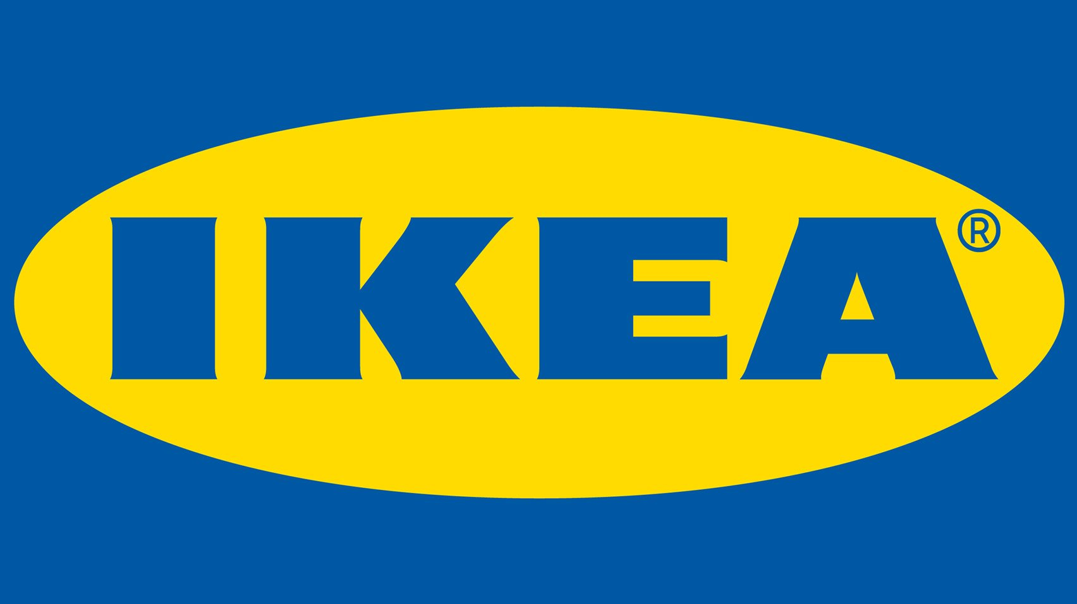
Design Choices for each Value Proposition
What It Is and Why It Is Important
Key Strategic Choices
Diagnostic Questions
Key Concepts & Frameworks
IKEA made trade-offs (reflected in their value curve) that enable their cost structure and while serving their target customers’ priorities.
It chose a number of attributes that increased customer WTP, across functional, emotional and experiential dimensions.
It reduced elements that were less relevant to its target customer segments.
Example: Strategy Value Curve of IKEA
Target Customer Segments: Young furniture buyers who want style at low cost, are willing to trade off service for cost, likely to have children, work for a living, and need to shop at odd hours.
Product/Service Portfolio: Modular, ready-to-assemble furniture designed in-house, displayed in room-like settings with clear in-store displays, plus complementary services like in-store childcare and extended hours.
Value Proposition Statement: "Democratic design accessibility" - stylish, affordable furniture that customers can take home immediately and assemble themselves, making good design accessible to everyone.
Cost-Reducing Attributes: Customer self-service model eliminates sales staff costs, customers handle their own pickup and delivery, flat-pack design reduces transportation and storage costs, and in-house design capabilities reduce supplier dependency.
Complements: Restaurants and food markets that make shopping trips more convenient; assembly services and car roof racks that support the self-service model.
Relative Price
Relative Performance
Design-focused competitors
Best-in-class
80
Offering level
IKEA
At-par
50
Basic retailers
Sub-par
30
Competing Factors

Slide 19
Design Choices for each Value Proposition
What It Is and Why It Is Important
Key Strategic Choices
Diagnostic Questions
Key Concepts & Frameworks
A subset of three strategic choices determine whether your offering will create sustainable competitive advantage.
Avoid trying to be “everything to everyone”.
Try to understand the broader set of alternatives customers consider.
The Subset of 3 Strategic Choices that determines advantage
1. Selection of Value
Attributes to Focus on
2. Choice of Competitive Benchmarks
3. Value Innovation Design
Eliminate
Reduce
Focus on Attributes that cascade directly your from strategic positioning archetypes.
Breakthrough Value Propositions often focus intensely on just 3-5 factors while systematically reducing or eliminating others.
Do not benchmark against all competitors, choose the most relevant ones.
Strategic Group Analysis options:
Direct competitors
Indirect competitors
Adjacent industries
Non-consumption
Raise
Create
Consider the four actions above to differentiate your offering and reduce costs through systematic value innovation.
Ensure that you:
Focus on select factors
Diverge from competitors
Have a compelling tagline

Slide 20
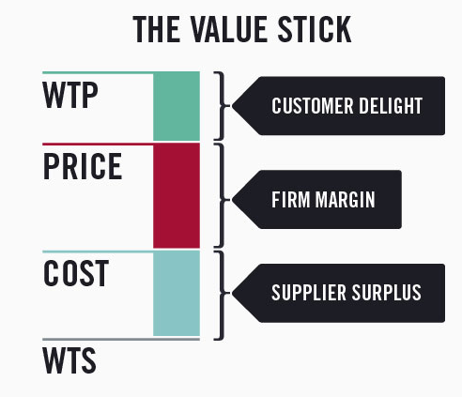
Choice of Strategic Pricing
What It Is and Why It Is Important
Key Strategic Choices
Diagnostic Questions
Key Concepts & Frameworks
Pricing can range between the customer’s WTP and the cost to the organisation. Increasing the margin decreases the customer delight, and vice versa. There are four distinct pricing approaches:
Premium Positioning
Value Positioning
Penetration Positioning
Dynamic Pricing
Examples of Strategic Pricing Approaches
Amazon Prime's Value Positioning
Tesla's Premium Positioning
Amazon balances value capture with compelling customer benefits.
Tesla captures high value by aligning price with customer WTP.
Adobe's Penetration Positioning
Uber's Dynamic Pricing
Adobe drives adoption by offering high customer value at moderate prices.
Uber adjusts prices to maximize revenue during high demand.

Slide 21



Diagnostic Questions (1/3)
What It Is and Why It Is Important
Key Strategic Choices
Diagnostic Questions
Key Concepts & Frameworks
Current
Strategic
Positioning
Value
Propositions
Segmentation
Differences vs
Competitors
Understand how
customers and
competitors perceive you.
How many you have
and how effectively they
deliver value.
Identify your position in
relation to competitors
and what sets you apart.
Question 1 Data Sources | Customer Interviews | Interviews with Sales Personnel | Competitive Intelligence | Voice of the Customer Studies | Management interviews | Mgt Control system
Which Generic Strategy describes us? | Yes | Yes | Yes | Yes | Yes
What positioning archetypes better describe us? | Yes | Yes | Yes | Yes | Yes
What is the positioning of your key competitors? | Yes | Yes | Yes | Yes | Yes
How clearly articulated is our VP? | Yes | Yes |  | Yes | Yes
Evidence of competitive advantage? | Yes | Yes | Yes |  | Yes | Yes
Where is there lack of coherence? | Yes | Yes |  | Yes | Yes | Yes

Slide 22
Diagnostic Questions (2/3)
What It Is and Why It Is Important
Key Strategic Choices
Diagnostic Questions
Key Concepts & Frameworks
Current
Strategic
Positioning
Value
Propositions
Segmentation
Differences vs
Competitors
Understand how
customers and
competitors perceive you.
How many you have
and how effectively they
deliver value.
Identify your position in
relation to competitors
and what sets you apart.
Question 2 Data Sources | Marketing assets review | Interviews with Marketing team | Interviews with Sales team | Customer Journey studies | Mgt Control System/CRM | Pricing Policies review
How many distinct value propositions? | Yes | Yes | Yes | Yes |  | Yes
Deliberately designed or emergent? |  | Yes | Yes |  | Yes | Yes
Clearly defined target customer segments? | Yes | Yes | Yes | Yes | Yes
Product/service portfolio fit? | Yes | Yes | Yes | Yes | Yes
Sufficiently tailored to target customers? | Yes | Yes | Yes | Yes
Relative price position deliberate and aligned? | Yes | Yes | Yes |  | Yes | Yes
Where is there value proposition drift? | Yes | Yes | Yes | Yes | Yes
Compelling value proposition statements? | Yes | Yes | Yes
Value attributes for WTP vs cost impact? | Yes | Yes | Yes | Yes
Gaps or inconsistencies across elements? | Yes | Yes | Yes | Yes | Yes | Yes

Slide 23
Diagnostic Questions (3/3)
What It Is and Why It Is Important
Key Strategic Choices
Diagnostic Questions
Key Concepts & Frameworks
Current
Strategic
Positioning
Value
Propositions
Segmentation
Differences vs
Competitors
Understand how
customers and
competitors perceive you.
How many you have
and how effectively they
deliver value.
Identify your position in
relation to competitors
and what sets you apart.
Question 3 Data Sources | Interviews with customers | Interviews with Product team | Interviews with Sales team | VOIC studies | Mgt Control/CRM System | Price Benchmarks | Interviews with KOLs | Competitors research
Who are our most significant competitors? | Yes | Yes | Yes | Yes | Yes | Yes | Yes
How do customers compare our VP to competitors? | Yes | Yes | Yes | Yes | Yes |  | Yes
Which value attributes do we outperform competitors on? | Yes | Yes | Yes | Yes | Yes |  | Yes | Yes
Where do competitors outperform us on key attributes? | Yes | Yes | Yes | Yes | Yes |  | Yes | Yes
What attributes have the biggest impact on our costs? |  | Yes |  |  | Yes
How does our actual price compare to competitors? | Yes | Yes | Yes |  | Yes | Yes |  | Yes
Which competitors have the highest customer WTP? | Yes | Yes | Yes | Yes | Yes |  | Yes | Yes
What value attributes are underserved by all competitors? | Yes | Yes | Yes | Yes |  |  | Yes
How sustainable are our advantages vs competitor threats? |  | Yes | Yes |  | Yes |  | Yes | Yes

Slide 24
Five Value Proposition Frameworks
What It Is and Why It Is Important
Key Strategic Choices
Diagnostic Questions
Key Concepts & Frameworks
These concepts help you understand the mechanics of value creation and guide your strategic choices about how to win in your chosen markets.
Together, they form a comprehensive foundation for creating winning value propositions that customers find compelling and competitors find difficult to imitate.
Value Stick Framework
Provides an economic model for understanding value creation and capture.
1
Elements of Value Framework
Identifies and measures value elements driving customer loyalty.
2
Frameworks for value proposition strategic decision-making
3
Three Value Disciplines
Focuses on achieving market leadership through focused excellence.
4
Jobs to Be Done Framework
5
Shifts focus to the progress customers seek in specific circumstances.
Four Actions Framework
Creates uncontested market space through value innovation.

Slide 25
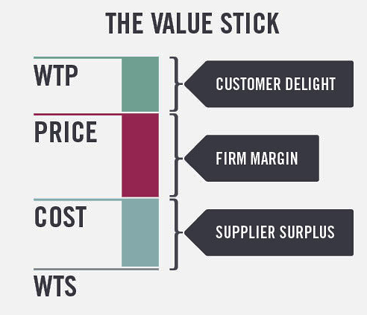
The Value Stick Framework
What It Is and Why It Is Important
Key Strategic Choices
Diagnostic Questions
Key Concepts & Frameworks
Value Created: the total economic value created, measured as the difference between WTP and WTS (the length of the stick).
Value Captured: how created value is distributed (to customer, firm and supplier).
Every strategic choice must ultimately contribute to increasing WTP or lowering WTS to create sustainable competitive advantage.
Maximum customer price perception
Actual amount charged
Total cost to produce a product/ service
Minimum compensation for suppliers
Example: Michelin's Value Revolution
Emotional Benefits
Provided peace of mind through guaranteed uptime and roadside assistance programs.
Increased WTP
Functional Improvements
Customers were willing to pay more due to lower total cost of ownership.
Developed tires that reduced fuel consumption by 3-7%, saving trucking companies thousands of dollars annually.
Reduced Competition
WTS Reduction Strategy
Competitors found this model difficult to replicate because it required integrated capabilities in tire technology, monitoring systems, and service delivery.
Traditional tire companies competed primarily on price, treating tires as commodities where WTS reduction was the main strategy.
Experience Enhancement
Premium Pricing
Strategic Pricing
Michelin captured premium pricing while customers achieved lower overall operating costs.
Introduced tire pressure monitoring systems and predictive maintenance services that prevented costly breakdowns.
Introduced "pay-per-mile" pricing, aligning incentives with customer value creation.
Source: Better Simpler Strategy, Felix Oberholzer-Gee, 2019

Slide 26
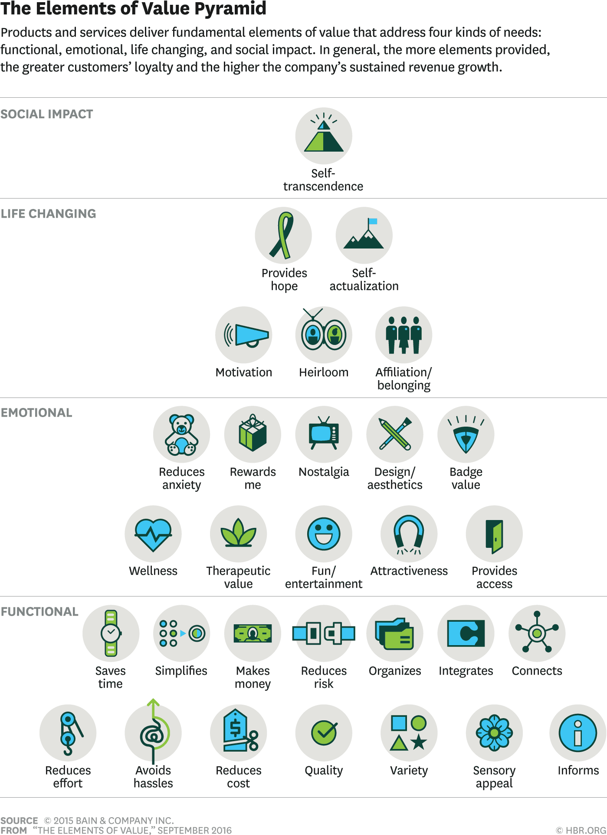
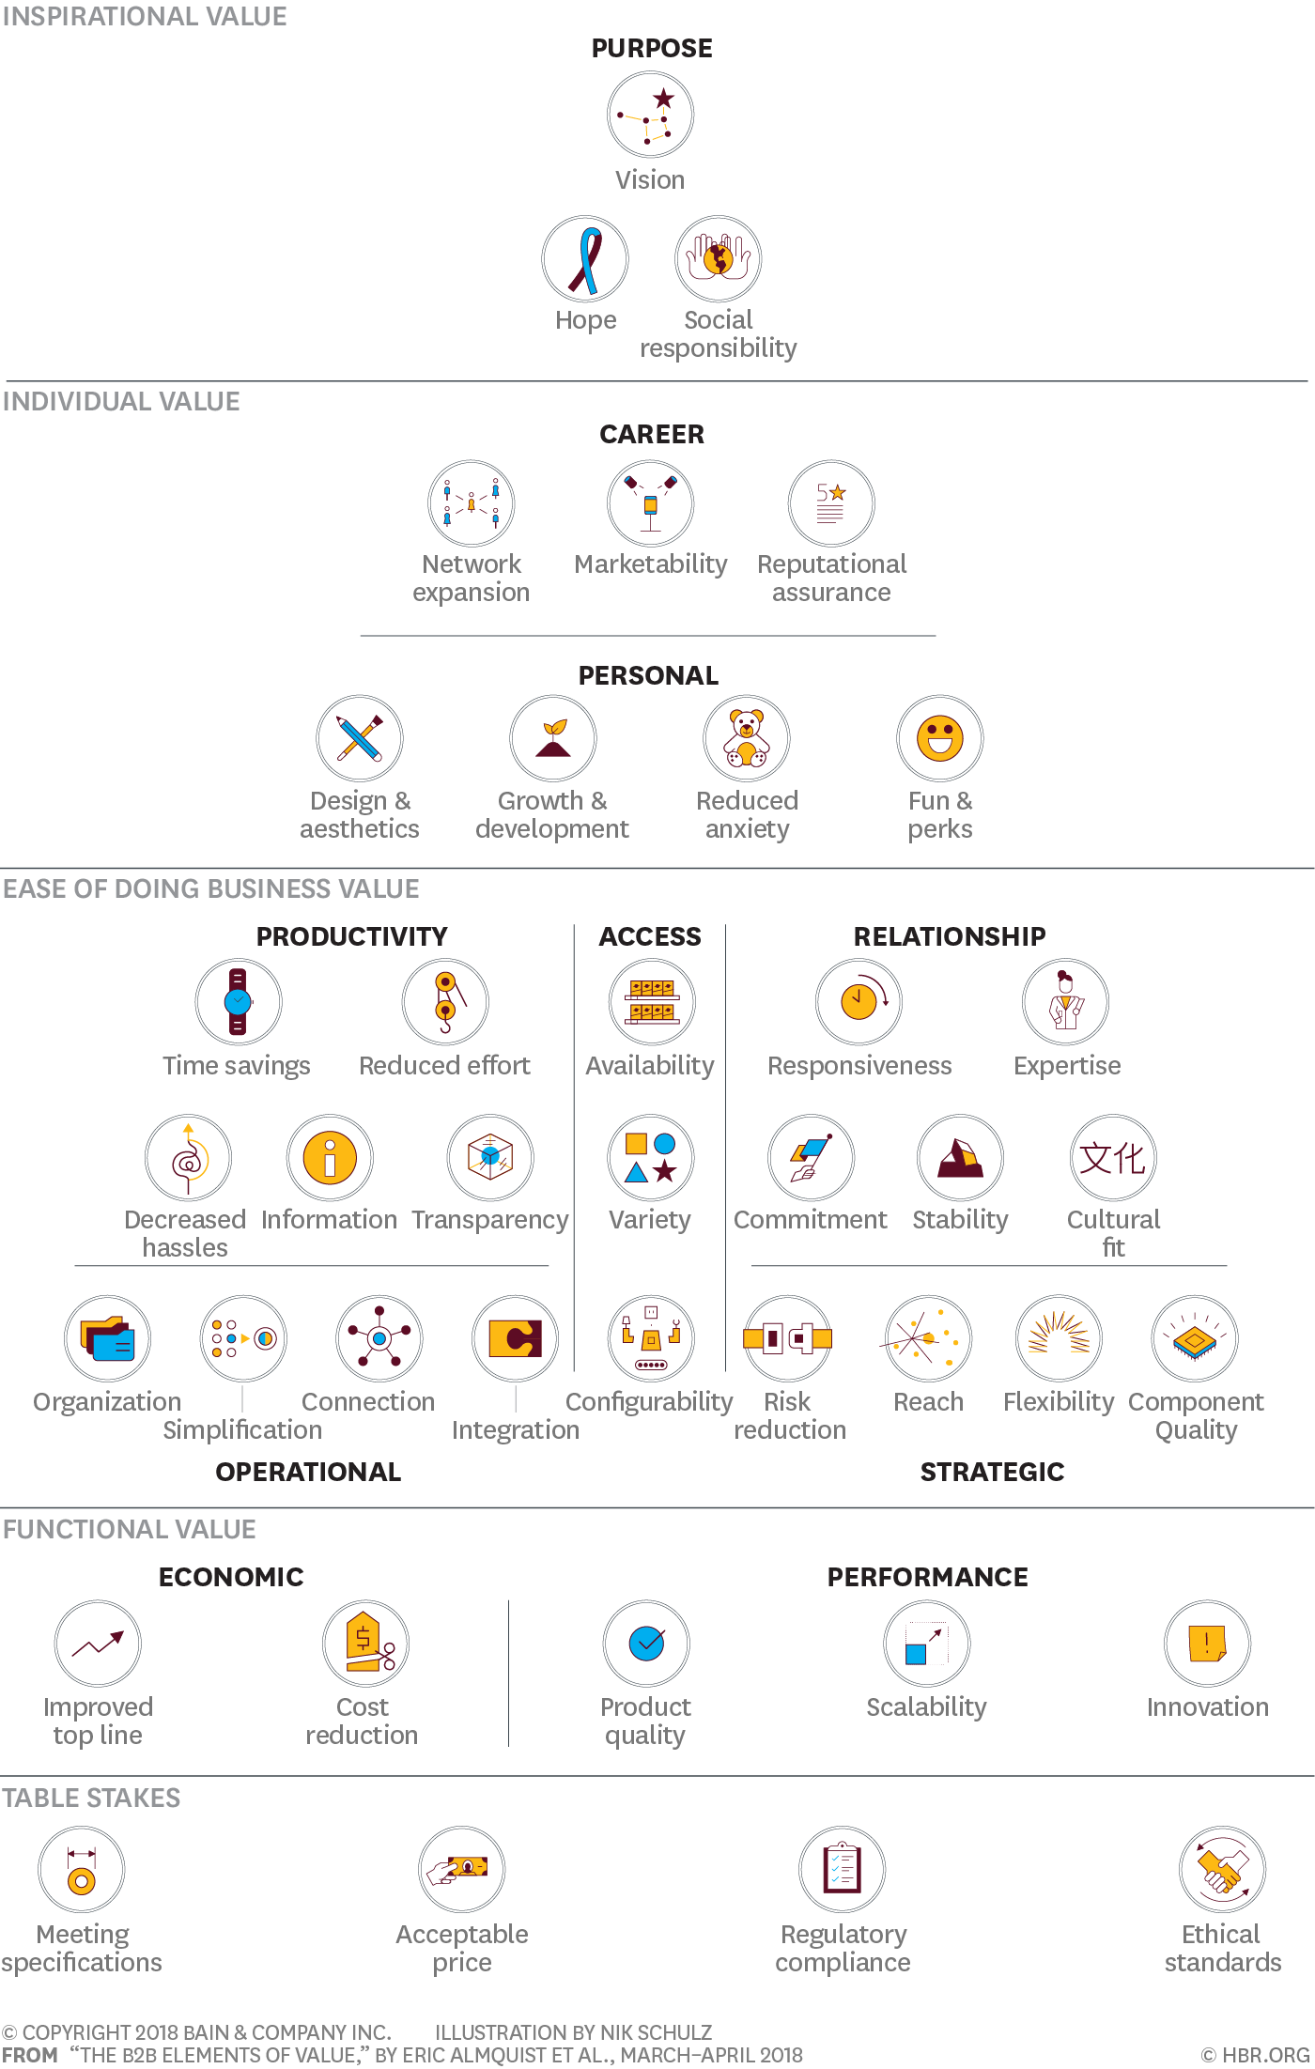
The Elements of Value Framework
What It Is and Why It Is Important
Key Strategic Choices
Diagnostic Questions
Key Concepts & Frameworks
The Elements of Value Framework provides a comprehensive taxonomy of value sources that customers perceive across both consumer (B2C) and business (B2B) markets.
This framework enables systematic identification and measurement of value elements that drive customer loyalty and revenue growth, moving beyond intuitive assumptions about what customers value to evidence-based value proposition design.
Research demonstrates that companies excelling on multiple value elements achieve significantly higher customer loyalty and revenue growth. Companies scoring high on four or more elements had three times the Net Promoter Score and four times the revenue growth compared to companies with only one high score.
B2C Elements
B2B Elements
Strategic Implentation Approach
Customer Feedback
Identify and Measure Elements
Analyze Loyalty Drivers
Select Strategic Elements (4-6)
Systematic Value Enhancement
Enhanced Customer Loyalty &
Opportunities for Value Innovation
Source: Almquist, Senior, Bloch & Cleghorn, 2016-2018

Slide 27


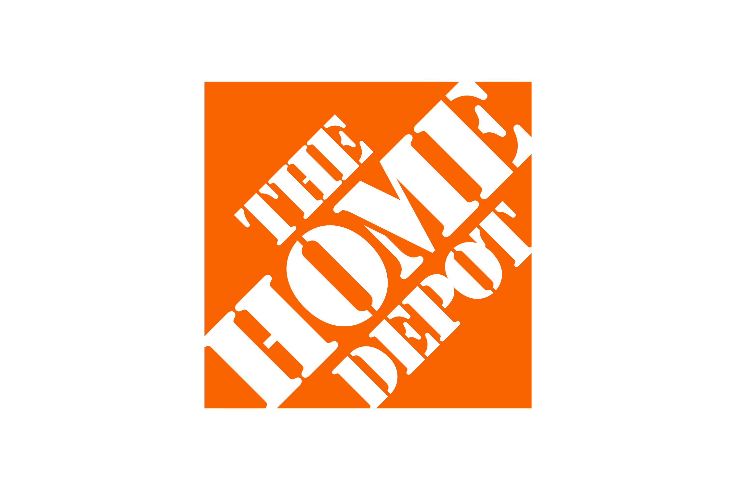
The Three Value Disciplines Framework
What It Is and Why It Is Important
Key Strategic Choices
Diagnostic Questions
Key Concepts & Frameworks
To achieve sustained competitive advantage, excel in one value discipline and maintain threshold in the other two. Dominate your market by improving continuously. Build a superior operating model to deliver your value proposition.
The choices of value discipline and customer category are actually one choice.
Companies pursuing the same value discipline have remarkable similarities regardless of industry.
Some companies successfully master two disciplines by resolving inherent tensions between different operating models.
Example: Nike
Example: Dell
Nike excels in product leadership in sport shoes by continuously pushing performance boundaries through innovation in materials, design, and technology.
Dell focused on the delivery system instead of the product, selling directly to customers, enabling high-quality products at low prices
Product Leadership
Operational Excellence
Strives for continuous innovation and cutting-edge products to outpace competitors.
Focuses on efficiency and cost reduction to deliver reliable products at competitive prices.
Customer Intimacy
Emphasizes understanding and catering to individual customer needs for long-term value.
Example: Home Depot
Home Depot focuses on customers’ needs for information and service, not just inexpensive products. Their forte is individual service.
Source: Customer Intimacy and Other Value Disciplines, Treacy & Wiersema, 1993

Slide 28
The Jobs To Be Done Framework
What It Is and Why It Is Important
Key Strategic Choices
Diagnostic Questions
Key Concepts & Frameworks
The fundamental insight is that customers don't buy products—they "hire" them to get a job done. When a product does the job well, customers hire it again. When it fails, they "fire" it and look for alternatives. Correlation-based customer data (demographics, etc.) fails to capture the actual reasons behind purchase decisions.
The framework transforms value proposition development by: Revealing True Competition, Identifying Emotional Dimensions, Uncovering Hidden Segments, Guiding Feature Prioritisation and Enabling Predictive Innovation.
The JTBD Framework Architecture
Top Jobs to Be Done Success Stories
Identify Core Functional Job
Evaluate Financial Outcomes
Recognize Related Jobs
1
2
3
Define Desired Outcomes
Understand Emotional Jobs
Southern New Hampshire University
Reese's Minis
Detroit Condo Development
Reese's Minis revolutionized snacking with convenient, one- handed consumption.
Analyse Consumption Chain Jobs
Consider Social Jobs
Detroit Condo Development boosted sales by addressing emotional moving anxieties.
SNHU transformed online education by focusing on career advancement needs.
Universal Job Map
Define Market Around Job-to-Be-Done
Quantify Over/ Under-served Outcomes
Align Existing Products
Identify the group of people and their job
Survey and calculate opportunity scores
Match products to outcome-based segments
Uncover Customer Needs (Desired Outcomes)
Discover Hidden Segments
Conceptualise New Products
Identify unique customer segments
Develop solutions for underserved outcomes
Source: Know Your Customers' "Jobs to Be Done", Clayton Christensen, 2016; Outcome-Driven Innovation, Anthony Ulwick, 1991
Structure and understand customer needs

Slide 29

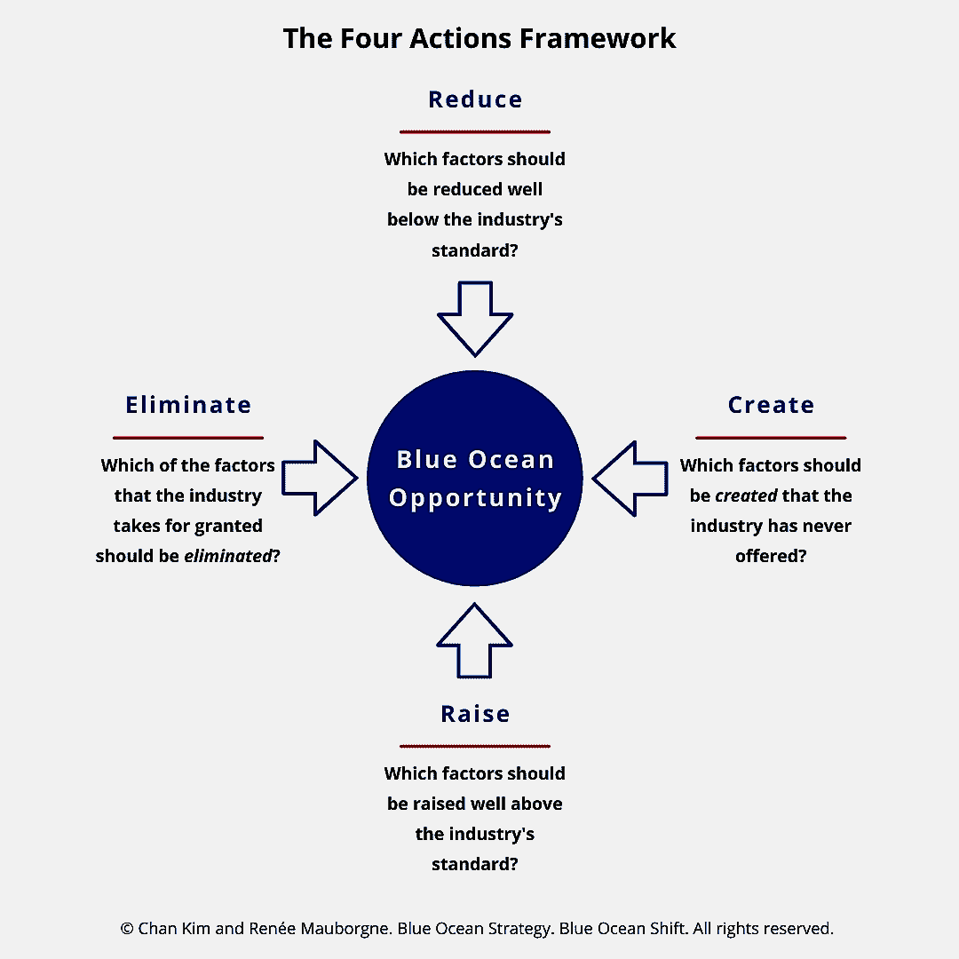

The Four Actions Framework
What It Is and Why It Is Important
Key Strategic Choices
Diagnostic Questions
Key Concepts & Frameworks
Blue Ocean Strategy revolutionises competitive thinking by shifting focus from competing within existing market boundaries to creating uncontested market space through value innovation.
This framework challenges the fundamental strategic assumption that companies must choose between differentiation and cost leadership.
To reconstruct buyer value elements and craft a new value curve, the framework poses four key questions that challenge an industry's strategic logic and business model.
Wine Industry Redefinition
Wine complexity and traditional imagery were removed. Ageing qualities and terminology were also eliminated.
Wine variety was reduced to Chardonnay and Shiraz. Tannins and oak influence were also reduced.
Eliminated
Reduced
Easy drinking and a fun personality were raised. Retail staff engagement was also raised.
Ease of selection and a vibrant identity were created. Social drinking experience was also created.
Raised
Created
Entertainment Innovation
Animal shows and star performers were eliminated to reduce costs. Ethical concerns were also addressed.
Eliminated
Reduced
Humour and danger elements were reduced to shift towards sophistication. Thrill elements were also toned down.
Venue experience and artistic quality were raised for sophistication. Intellectual elements were also enhanced.
Theme, storyline, and original scores were created for uniqueness. Artistic dance and lighting were also added.
Raised
Created
Source: Blue Ocean Strategy, Kim & Mauborgne, 2005

